Slide 1
“Beijing is far away”: The Provinces in China
CEAS/SIS/JNU
25 October 2010
Jabin T Jacob
Senior Research Fellow
Institute of Peace and Conflict Studies (IPCS)
New Delhi

Slide 2
STUDYING PROVINCES
Levels of Analysis
  1. centre-province
    when competitive – LOCALISM
  2. inter-province
    when competition – PROVINCIALISM
    when cooperation – REGIONALISM
  3. province-foreign country – TRANSNATIONALISM
  4. intra-province

Slide 3
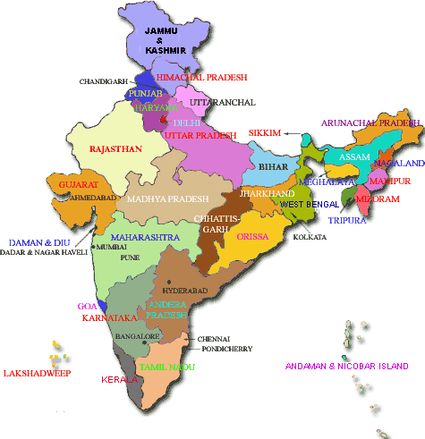
INDIA’S STATES
1947-1989 - federal, single-party
post-1989 – federal, multi-party, reforms and opening up of economy
hierarchy of states
  1947-1989
    members in Parliament
    GDP
  post-1989
    world trade, FDI
    education, infrastructure
    diaspora
influence exercised/constrained
  1947-1989
    members in Parliament
    location / national security
  post-1989
    coalition governments

Slide 4
CHINA’S PROVINCES
Provinces
Autonomous Regions
Municipalities
Special Administrative Regions
“Renegade” Province

Slide 5
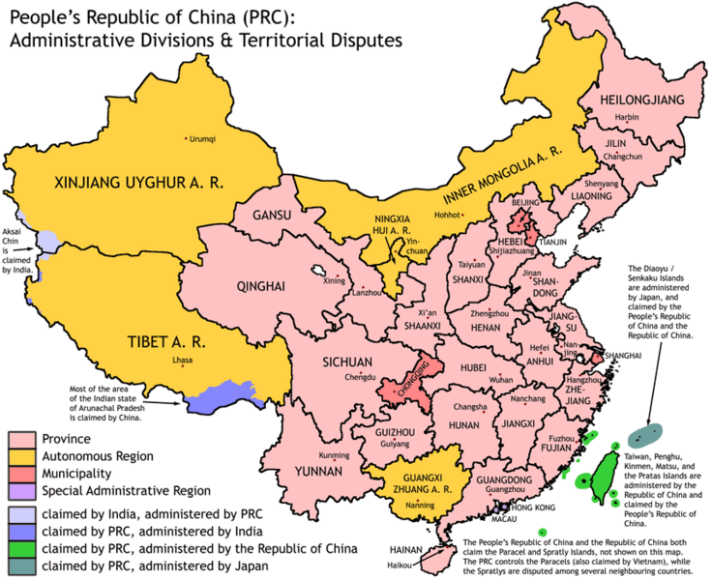

Slide 6
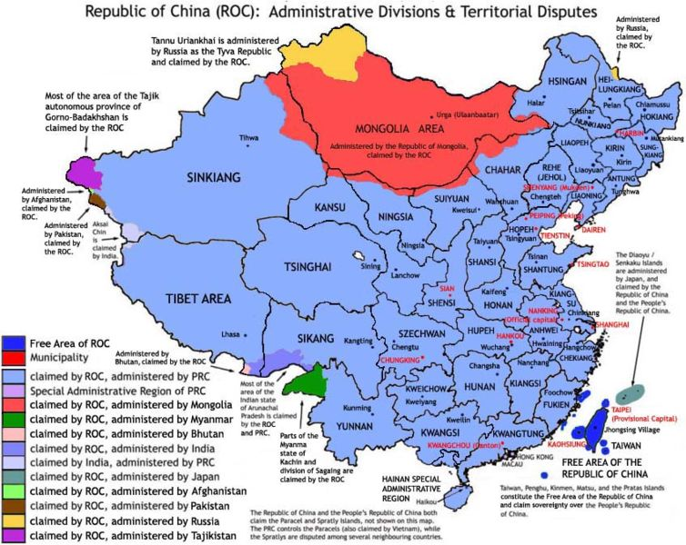

Slide 7
1. LOCALISM
(centre-province competition)
tiáo/kuài guānxi
constitutional position of provinces
authority fragmented
strong state capacity needs to exist at both central and local levels
issues
  resource allocation (preferential policies), revenue collection
  cadre origins, appointment, training and promotions
  implementation of central laws and regulations
    environmental policy
    economic reforms – implementation, initiative, WTO accession
in the PRC
  Mao – “Hyperstatized and yet politically parcelized?”
  Deng – high level of decentralization, declining central revenues
  Jiang – recentralization of power, 1994 tax reforms, greater institutionalization, rotation of cadre
  Hu – recentralization of power, deepening of institutions, greater predictability

Slide 8
LOCALISM IN INDIA
(centre-province competition)
constitutional position of the states
authority fragmented by coalition politics
strong state capacity needs to exist at both central and local levels
issues
  central control - bureaucratic appointments, funding
  implementation of central laws and regulations
    environmental policy
    economic reforms – implementation, initiative
  political
    Gujarat v/s New Delhi
    Uttar Pradesh v/s New Delhi
    Tamil Nadu v/s New Delhi
  revenue collection
    VAT, GST

Slide 9
2A. PROVINCIALISM
(inter-province competition)
Economic dynamics
  “ladder-step theory”
  disparities
  economic protectionism
  exit and voice
  dependency – central government, richer provinces
Political / Cultural dynamics
  Mao / GPCR
  culture / ethnicity
    “Chineseness” – Yellow Emperor – Henan and Shaanxi
    identity politics – Anhui , Guizhou, Yunnan
    Sinification – Tibet, Xinjiang
Notes:
“ladder-step theory” (tīdù kāifa lǐlùn)

Slide 10
PROVINCIALISM IN INDIA
(inter-province competition)
Political dynamics
  Chandigarh –Punjab v/s Haryana
  Belgaum – Karnataka v/s Maharashtra
Cultural/Ethnic dynamics
  migrant labour – Maharashtra, Delhi v/s Bihar
Resource competition
  river waters – Kerala, Tamil Nadu, Karnataka, Andhra Pradesh
Economic dynamics
  TATA Nano – West Bengal, Gujarat

Slide 11
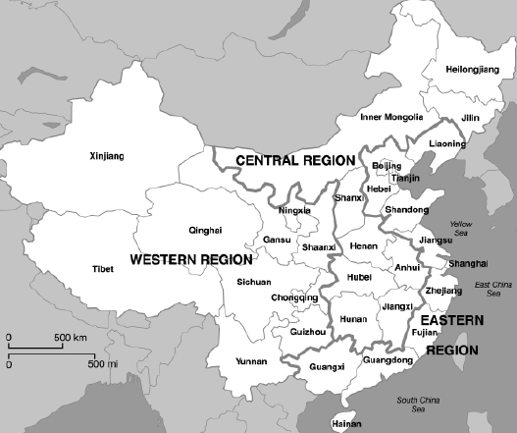
2B. REGIONAL CHINA

Slide 12
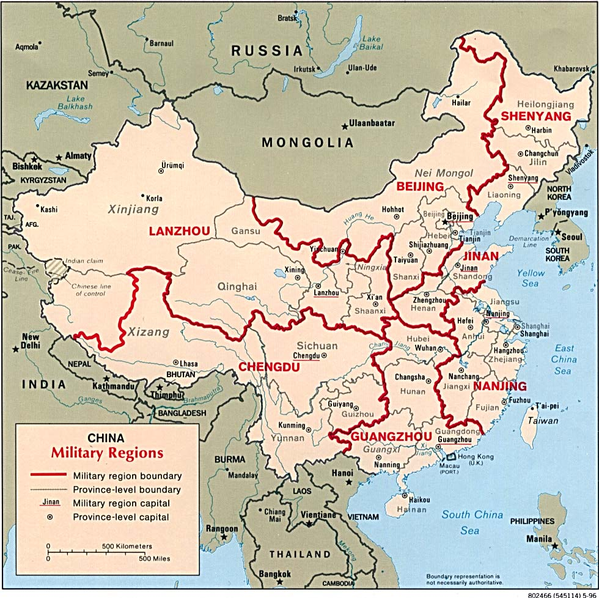
2B. REGIONALISM
(inter-province cooperation)
Rationale for identifying a Region
  natural geography – rivers, mountains
  economic – study, growth-centres, central inability, resource allocation/requirements
  military
  history
Rationale for regional cooperation
  pushed by the centre
    GARs
    6th FYP (1981-85) Economic Coordination Areas
    7th FYP (1986-90) 3 regions – Western Region
    9th FYP (1996-2000) growth centres – PRD, YRD
  political bargaining with the centre – Central Chinese provinces
  economies of scale – PRD, YRD
  construction of physical infrastructure
  shared economic interests - Hubei
Notes:
A unique joint editorial published on 1 March 2010 by 13 independent-leaning Chinese media outlets, spread across 11 provinces and cities, in the lead-up to the annual session of the national legislature, stated, "We hope that decades of Chinese government maladministration can end with this generation. . . . Let the next generation enjoy the sacred constitutional guarantees of freedom, democracy and equality." The target of criticism was the Chinese household registration, or hukou, system. The editorial, while indicating growing popular pressure for reform of the system also displays the ability to network across provincial boundaries and it is reasonable to expect that provincial officials too, have a similar ability to form coalitions across provincial boundaries and on a variety of issues.
Carl Minzner, “The system that divides China,” Los Angeles Times, 16 March 2010, http://www.latimes.com/news/opinion/commentary/la-oe-minzner16-2010mar16,0,6869961.story.

Slide 13
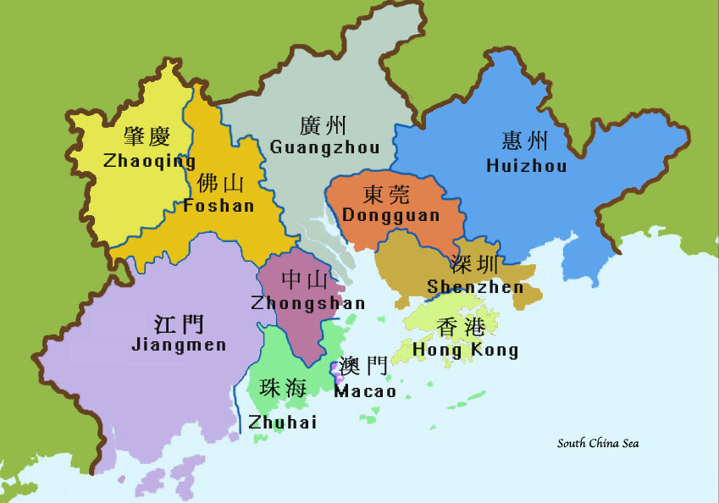
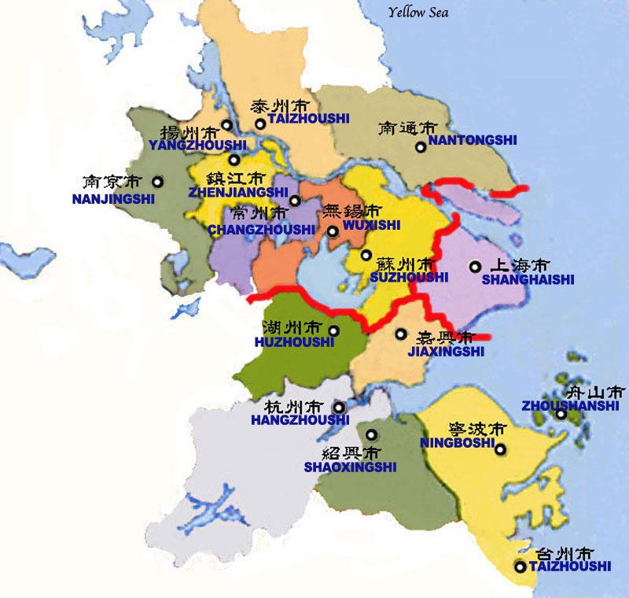
2B. REGIONALISM
(inter-province cooperation)
Pearl River Delta
Yangtze River Delta

Slide 14
REGIONALISM IN INDIA
(inter-province cooperation)
Rationale for identifying a Region
  natural geography
    Himalayan states; Northeast India
  cultural / ethnic
    north v/s south; Northeast India
  political violence
    insurgency-affected states; Naxalism-affected states / “Red Corridor”
  economic
    north; south; west; east
  military
Rationale for regional cooperation
  political bargaining with the centre – Northeast India
  economies of scale
  construction of physical infrastructure – NCR
  shared economic interests

Slide 15
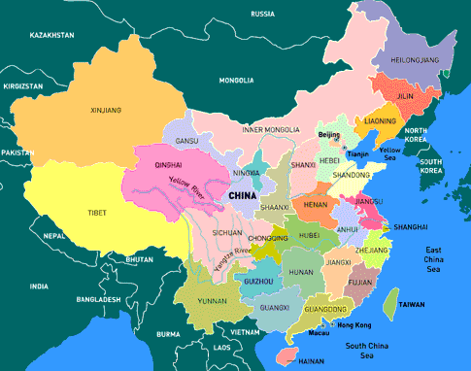
3. TRANSNATIONALISM
(province-foreign country relations)

Slide 16
3. TRANSNATIONALISM
(province-foreign country relations)
economic influence to political influence
  Hong Kong, Macao
  Taiwan
who is in charge? centre?
  Japan
  India
  Central Asia
who is in charge? province?
  Southeast Asia
who is in charge? neither?
  S Korea
  Russian Far East

Slide 17
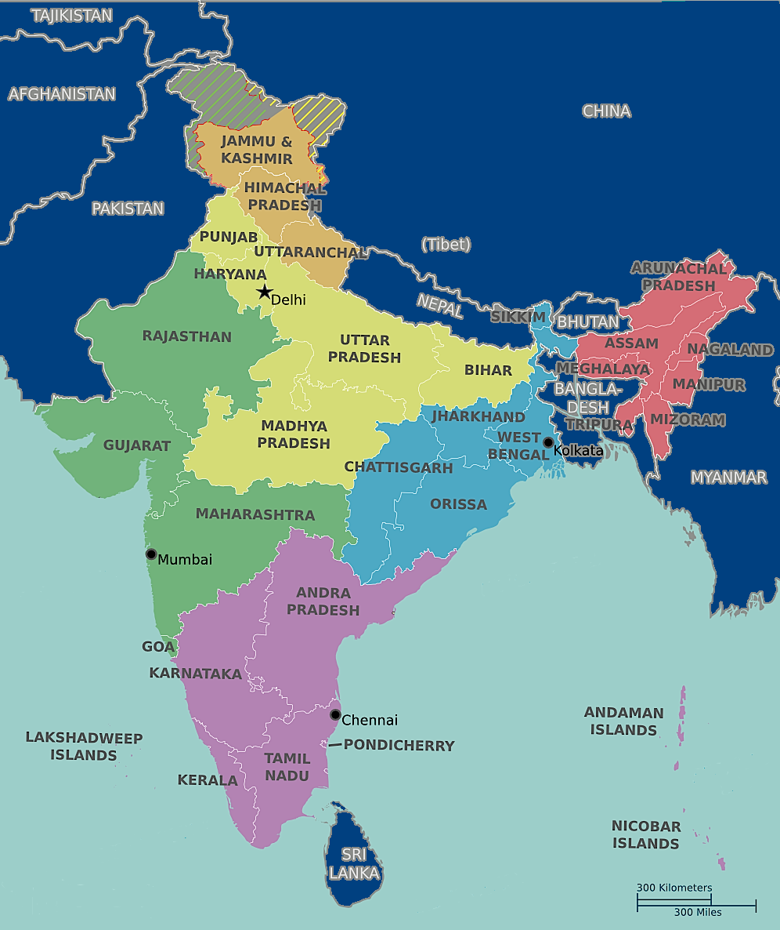
TRANSNATIONALISM IN INDIA
(province-foreign country relations)

Slide 18
4. OTHER ISSUES
intra-province
  Bihar-Jharkhand; Madhya Pradesh-Chattisgarh; UP-Uttaranchal
  J&K – Kashmir, Jammu, Ladakh, Kargil
  Uttar Pradesh; Maharashtra; Andhra Pradesh
  Jiangsu; Xinjiang
  Guangdong-Hainan Island; Sichuan-Chongqing
  Tibet – (U-Tsang, Kham, Amdo); – TAR, Qinghai, Yunnan, Sichuan, Gansu
rise of cities / urban centres
  competition between urban centres
    New Delhi v/s Gurgaon v/s NOIDA
    Guangzhou v/s Shenzhen v/s Hong Kong
  competition within urban centres
    New Delhi - MCD, NDMC and the Cantonment Board
    Wuhan provincial government v/s Wuhan city government
Notes:
Uttar Pradesh – Harit Pradesh; Maharashtra - Vidharbha; Andhra Pradesh – Telengana, Rayalseema
Xinjiang – Dzungarian Basin in the north and the Tarim Basin in the south

