Slide 1
POLITICAL ECONOMY OF ARUNACHAL PRADESH
IN A RISING INDIA
Center for China’s Borderland History and Geography Studies
Chinese Academy of Social Sciences, Beijing
14 December 2010
Jabin T Jacob, PhD
Senior Research Fellow,
Institute of Peace and Conflict Studies
New Delhi, India
www.ipcs.org

Slide 2
Outline
A. Historical Legacy
B. Politics and Administration
C. Security Considerations
D. Rising India and Arunachal Pradesh

Slide 3
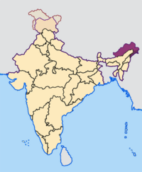

Slide 4
A. Historical Legacy
Border provinces in India have been traditionally ignored by policymakers
  politically
  economically
  socially
  infrastructure development

Slide 5
A. Historical Legacy
Arunachal is no exception…
politically
  Independent India’s first Home Minister, Sardar Patel’s warning to Jawaharlal Nehru, that the Northeast region provided “unlimited scope for [Chinese] infiltration” and that “the people inhabiting these portions have no established loyalty to India” seems to have taken the force of dogma especially following the defeat of the Indian Army at the hands of the Chinese in 1962.

Slide 6
A. Historical Legacy
economically
  no industry worth the name has ever been developed in Arunachal
  largely dependent on central government subsidies and contracts
socially
  Nehru’s Verrier Elwin-influenced policy of ‘preserving’ Arunachal’s unique ethnic heritage
    sort of museum of ethnicities, like Yunnan
  poor education, health and gender indicators
  many old tribal customs prevail
  no local newspapers, national newspapers arrive several days late

Slide 7
A. Historical Legacy
infrastructure development
  deliberate lack of physical infrastructure development owing to fears of another Chinese attack
  huge parts of the province cannot be accessed except through single-lane roads through very difficult terrain
  moreover, one part of the province may not be accessible from another, except through the state of Assam
  lack of mobile telephony and internet except in district headquarters

Slide 8
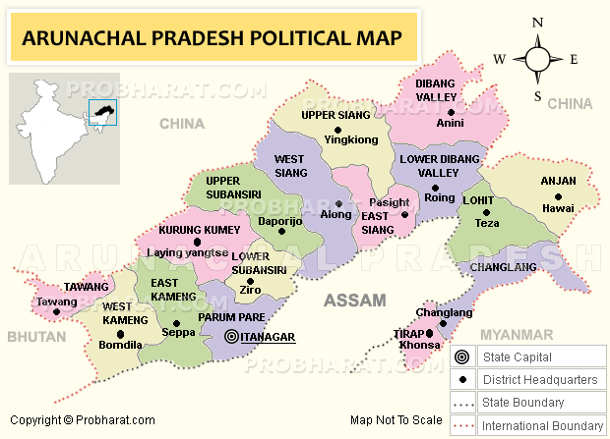

Slide 9
B. Politics and Administration
Arunachal in the Indian Parliament
  2 seats in Lower House out of 543
  1 seat in Upper House out of 250
2 major political parties, some local parties
  Congress (I) and BJP
Arunachal government has long had officers from other provinces in India because its own people did not have the education or the skills necessary to run government
however, this is now changing with younger generations of Arunachalis being better educated and being inducted into the Arunachal bureaucracy and other government institutions

Slide 10
C. Security Considerations
Inner Line Permit for both Indians and foreigners
boundary dispute with China
border villages have been abandoned and many now only see Indian Army presence
insurgencies in neighbouring provinces and insurgent groups using parts of Arunachal as safe havens

Slide 11
D. Rising India and
Arunachal Pradesh
Economic Development and its Consequences
Integration
c) Arunachal and Indian Foreign Policy

Slide 12
D. Rising India and
Arunachal Pradesh
a) Economic Development and its Consequences
  lack of local entrepreneurial capacity
  few public sector enterprises
  growing Indian economy has however, meant more money for the central government to spend on Arunachal’s development, including physical infrastructure
  hence there are huge contracts awarded to Arunachali citizens to build physical infrastructure
    one of the consequences has been large-scale corruption
  illegal trade
    goods from China found in Arunachali markets
    coming from Nepal and Bhutan

Slide 13
D. Rising India and
Arunachal Pradesh
Economic Development and its Consequences
  physical infrastructure development – dams, roads
    environmental concerns
      therefore, most dams are actually run-of-the-river projects
    concerns about social structure
      building of roads has consequences for societal structures and cohesion
      migration of people both into and out of Arunachal

Slide 14
D. Rising India and
Arunachal Pradesh
b) Integration
Indian central government is trying to better integrate Arunachal Pradesh with rest of the country
  by building better roads and telecommunication networks
  promoting Arunachal as a tourist destination for Indian and foreign tourists
  providing vacation subsidies to government employees to travel to Arunachal
  closer linkages with mainland India

Slide 15
D. Rising India and
Arunachal Pradesh
c) Arunachal and Indian Foreign Policy
Indians are increasingly aware of Arunachal’s position in Sino-Indian relations. Most Indians have not been to Arunachal, or do not know the full facts or history of Arunachal or the Sino-Indian conflict of 1962.
  but they can have strong opinions about Chinese claims to Arunachal. For example,
    Chinese ‘incursions’ across LAC
    China’s objection to ADB development loans to India for Arunachal
    Tawang
    Dalai Lama
    water issues

Slide 16
D. Rising India and
Arunachal Pradesh
c) Arunachal and Indian Foreign Policy
Public opinion in Arunachal too, is strongly pro-India and anti-communist China
  While originally Monpas did not get along well with Tibetans, following the Dalai Lama’s fleeing of Tibet in 1959 and the influx of Tibetan refugees since then, they have become more accepting of Tibetans
Political weight of Arunachal might be disproportionate to the numbers of its population or the strength of its representation in the Indian Parliament
  owing to Arunachal’s strategic location
  Arunachali politicians have been particularly vocal about China and they’re heard seriously by other Indian politicians

Slide 17
D. Rising India and
Arunachal Pradesh
c) Arunachal and Indian Foreign Policy
  Arunachal is also part of India’s Look East Policy
  Overall, however, Arunachalis are of the opinion that no real development can come to Arunachal until the boundary dispute with China is solved.

